Slide 1

Internship Project Presentation
Projects in Data Analytics & Machine Learning
Presented By
Namitha S Paragi
Data Analyst Intern
UNID: UMID09082554441

Slide 2

Project Overview
Internship Organization: Unified Mentor
Duration: 10/08/2025 to 10/11/2025
Domain: Data Analytics & Machine Learning
Tools: Python, SQL, Excel, Tableau, Machine Learning
Projects Covered:
1. Supply Chain Management Dashboard
2. Customer Satisfaction Prediction
3. IBM HR Analytics – Employee Attrition & Performance

Slide 3

Project 1:
Supply Chain Management Dashboard
Workflow: Excel → SQL → Tableau Visualization

Slide 4
Problem Statement
Objective: Build a real-time Tableau dashboard for better insights and profitability.
Problem Context:
The company struggled with delayed deliveries, high transportation costs, and poor visibility into supplier performance.
Manual data tracking led to inefficiency in monitoring operations.
Inventory and cost data were stored separately, making insights difficult to extract.

Slide 5
Project Objectives
Objectives:
Create a centralized Tableau dashboard for real-time performance monitoring.
Measure profitability, inventory efficiency, and supplier reliability.
Visualize data trends to identify areas for cost optimization.
Provide actionable business recommendations backed by KPIs.

Slide 6
Data Preparation & Cleaning
Dataset: Fashion & Beauty supply chain data
Steps Taken:
Imported dataset from Excel into Tableau.
Removed duplicates and handled missing values.
Standardized units (₹ for costs, days for lead time).
Verified relationships between suppliers, SKUs, and product categories.
Key Columns: Product Type, SKU, Stock Levels, Revenue, Supplier Name, Lead Time, Shipping Costs, Defect Rates.

Slide 7
Tools & Technologies
Tool | Purpose
Tableau Desktop | Dashboard creation & visual analysis
Excel / CSV | Data cleaning & preprocessing
SQL | Metric validation & query analysis

Slide 8
Analytical Methods and Calculations
Key Calculated Fields:
Profit: [Revenue generated] - ([Manufacturing costs]*[Number of products sold]) - [Shipping costs]
Profit Margin (%): ([Profit]/[Revenue generated])*100
Supplier Performance Score: ([Lead time]*0.4)+([Defect rates]*0.4)+([Shipping costs]*0.2)
Stock-to-Sales Ratio: [Stock levels]/[Number of products sold]
Days of Inventory Remaining: [Stock levels]/AVG([Daily Sales])
Outcome: Clean, standardized dataset ready for Tableau visualization and interactive analytics

Slide 9
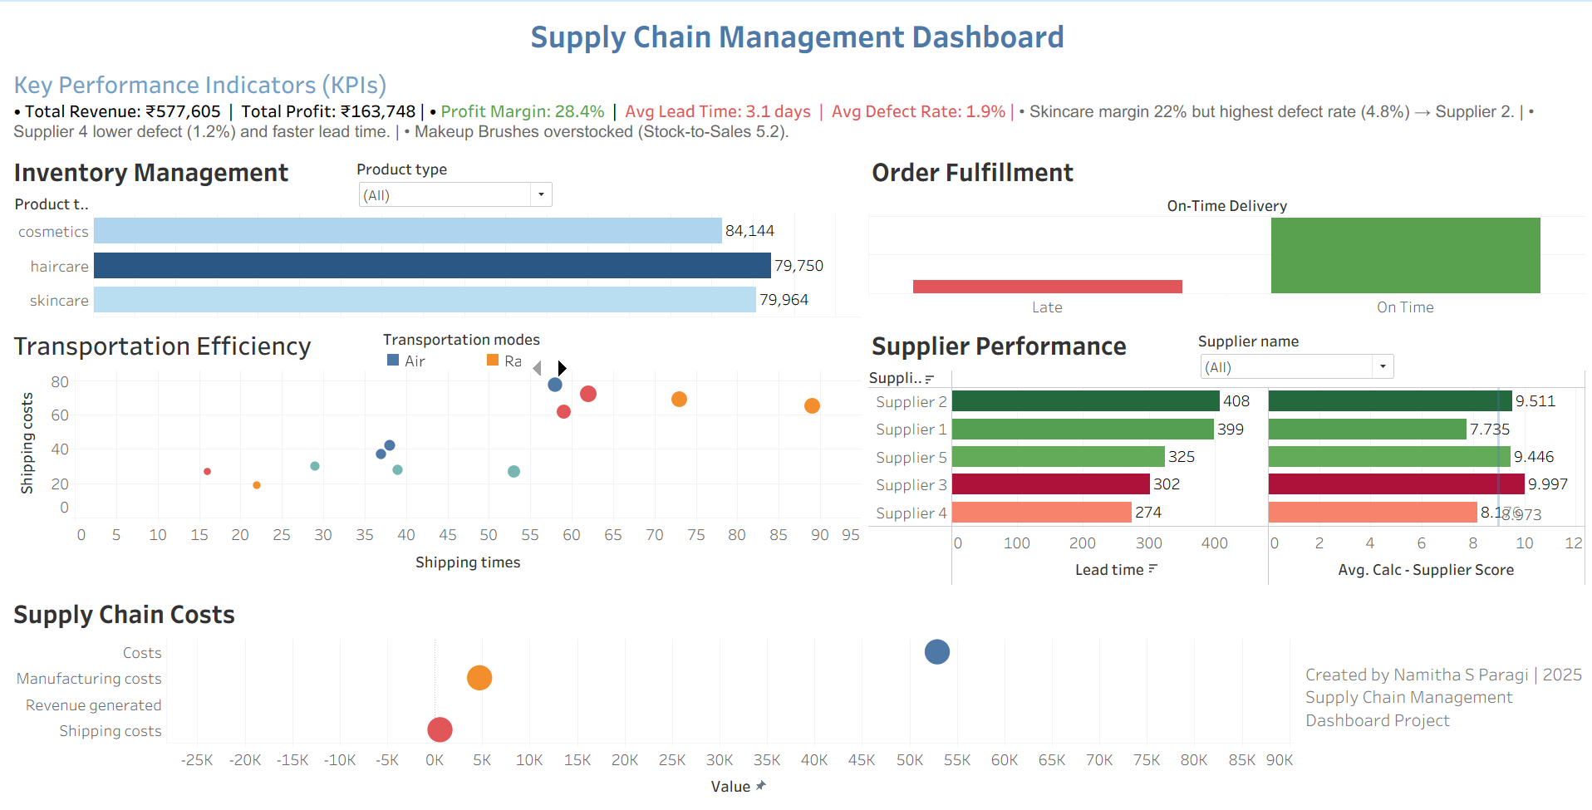

Dashboard Overview
Dashboard Modules:
Inventory Management
Order Fulfillment
Supplier Performance
Transportation Efficiency
Supply Chain Costs
Features:
KPI Banner for quick executive summary.
Filters for Product Type, Supplier, and Location.
Visual Story: From revenue tracking to cost optimization.

Slide 10
Key Performance Indicators (KPIs)
KPI | Description | Value
Total Revenue | Overall sales | ₹577,605
Total Profit | Revenue – Costs | ₹163,748
Profit Margin | Profit ÷ Revenue | 28.4%
Avg Lead Time | Supplier delivery time | 3.1 days
Avg Defect Rate | Product defects | 1.9%
On-Time Delivery | Orders delivered on time | 86%
Total Inventory Value | Current stock worth | ₹243,857

Slide 11
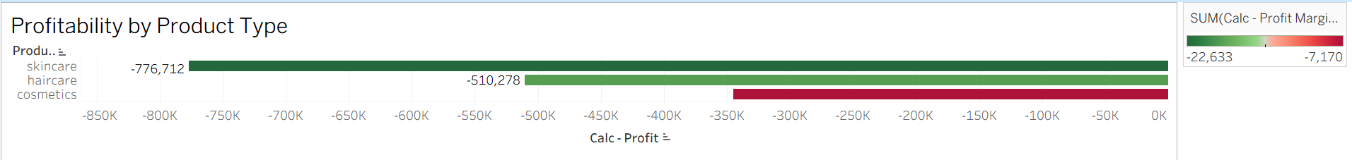
Financial Overview
Title: Profitability by Product Type
Insights:
Skincare products show highest margin (22%) but also highest defect rate (4.8%).
Haircare yields moderate profit with stable quality.
Cosmetics have low margin due to high shipping cost.
Conclusion: Focus on cost reduction for high-margin products.

Slide 12
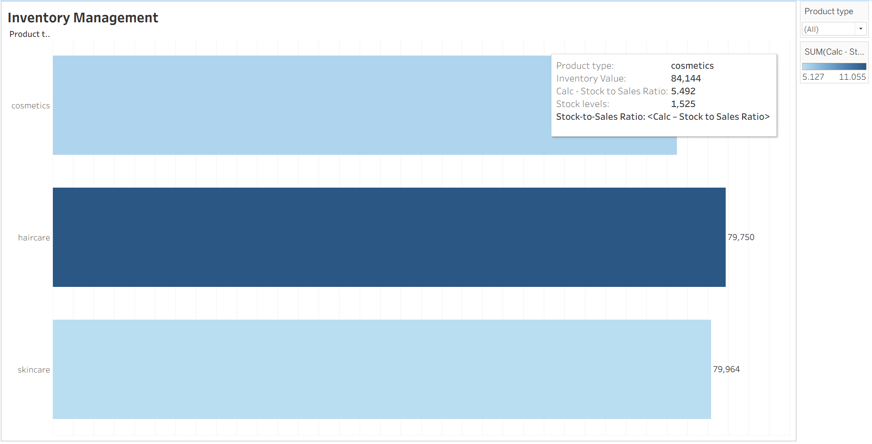
Inventory Management
Title: Stock Efficiency and Inventory Turnover
Findings:
Makeup Brushes have Stock-to-Sales Ratio = 5.2, indicating overstocking.
Most categories maintain healthy stock levels (~30 days).
Balanced replenishment improves capital utilization.
Recommendation: Reduce excess stock to free ~₹50,000 working capital.

Slide 13
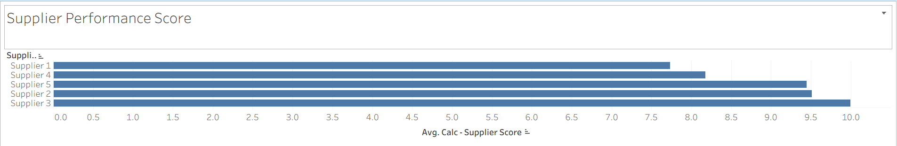
Supplier Performance Analysis
Title: Supplier Reliability Scorecard
Findings:
Supplier 2 → High defect rate (4.8%) & long lead time (4 days).
Supplier 4 → Best performer (1.2% defects, 2-day lead time).
Supplier 3 → Moderate consistency.
Recommendation: Prioritize Supplier 4 for critical products.

Slide 14
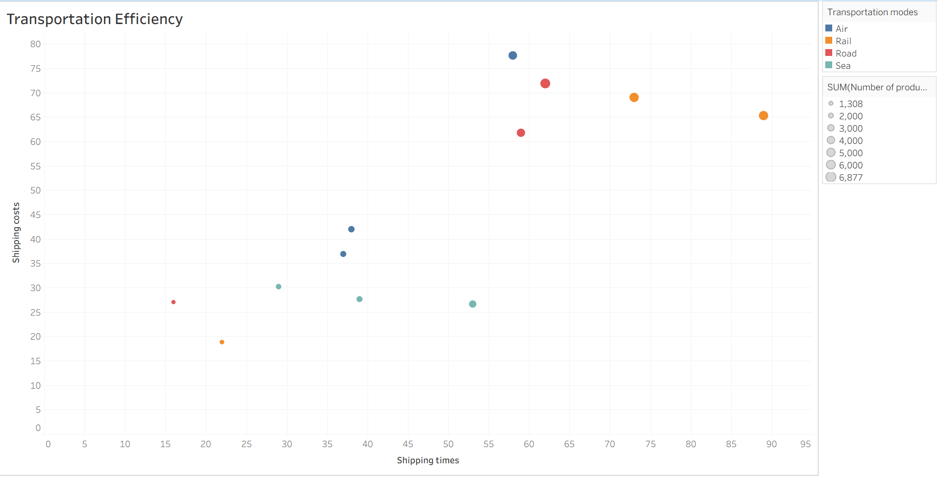
Transportation Efficiency
Title: Shipping Mode Analysis
Findings:
Air: Fastest but highest cost.
Rail: 40% cheaper, minor delay (2–3 days).
Road: Balanced option for mid-distance deliveries.
Recommendation: Use Rail for bulk non-urgent orders to reduce costs.

Slide 15
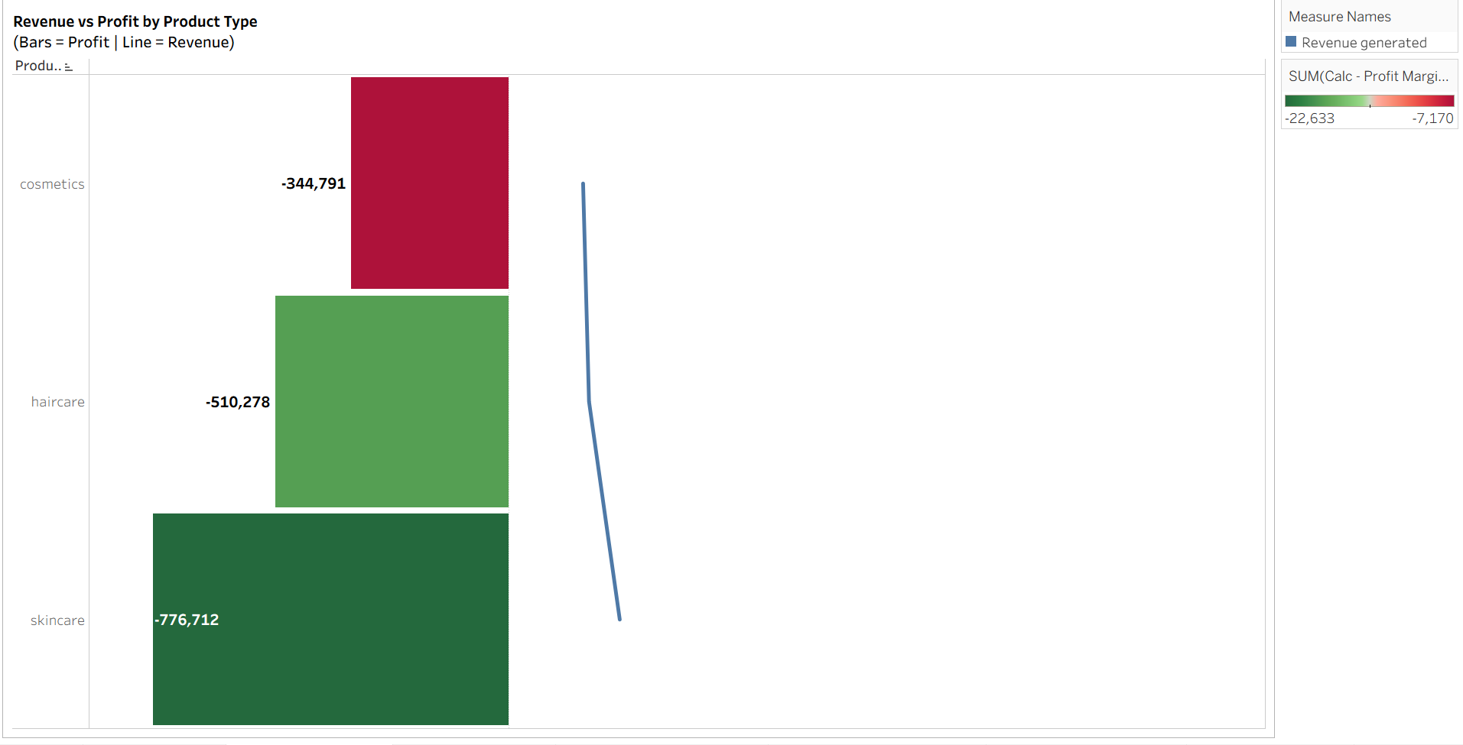
Supply Chain Cost Distribution
Title: Understanding Expense Composition
Cost Breakdown:
Transportation: 40%
Inventory Holding: 30%
Order Processing: 20%
Miscellaneous: 10%
Observation: Transportation dominates cost share — potential for optimization.

Slide 16
Key Insights & Recommendations
Insights:
Skincare = Profitable but high defect rate.
Supplier 4 = Optimal vendor choice.
Makeup Brushes = Overstock issue.
Air mode = Expensive but fastest.
Recommendations:
Shift skincare sourcing to Supplier 4.
Balance stock levels for slower-moving SKUs.
Optimize shipping mix (Rail for cost, Air for urgency).
Review supplier scorecards monthly.

Slide 17
Conclusion & Business Impact
Outcomes:
Enhanced visibility into entire supply chain.
Identified cost-saving opportunities (~10%).
Improved decision-making and supplier management.

Slide 18

Project 2: Customer Satisfaction Prediction
Data: Text feedback + resolution time used as features
Tools: Python, Scikit-learn, NLP, Tableau/Matplotlib

Slide 19
Introduction
Objective: To predict customer satisfaction levels based on support ticket data using Natural Language Processing (NLP) and Machine Learning techniques.
Goal: Help the customer-support team identify unhappy customers early and take proactive steps to improve experience.

Slide 20

Problem Statement
Customer feedback and support tickets contain rich information, but analyzing them manually is time-consuming.
The organization wants to automatically identify which customers are unsatisfied (ratings 1–3) and which are satisfied (ratings 4–5).
Key challenge: textual data (ticket descriptions) and time-related delays both influence satisfaction.

Slide 21
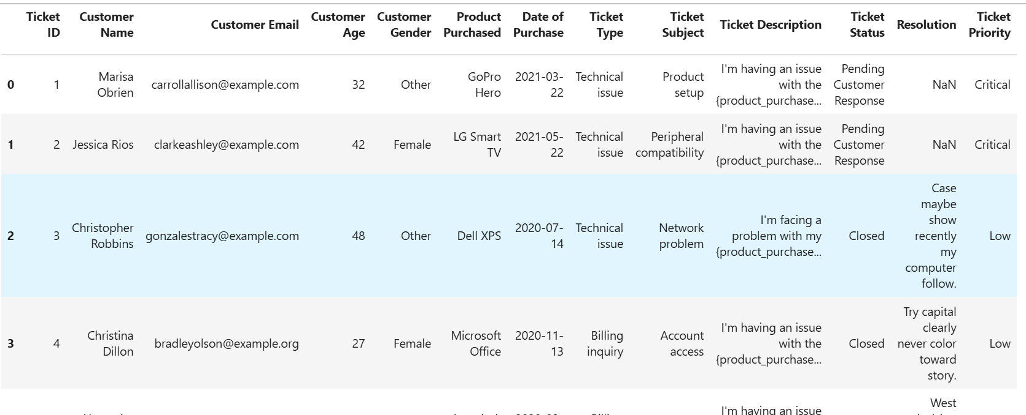
Dataset Overview
Source: Customer support tickets dataset (customer_support_tickets.csv)
Size: ~8469 rows × 17 columns
Observation: Most ratings are 4 or 5, indicating slight class imbalance.

Slide 22
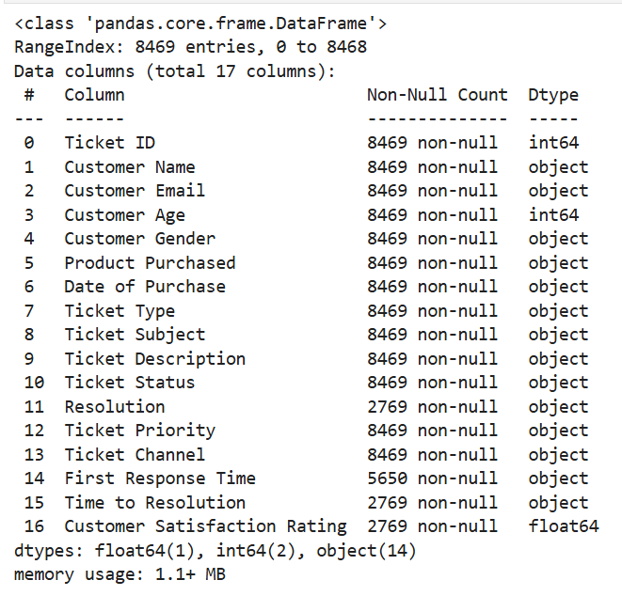
Data Cleaning & Preprocessing
Steps Taken:
Removed duplicates and null values.
Converted date columns to datetime format.
Derived time-based features:
Response_Duration_Minutes
Resolution_Duration_Hours
Ticket_Day_of_Week, Ticket_Hour_of_Day

Slide 23
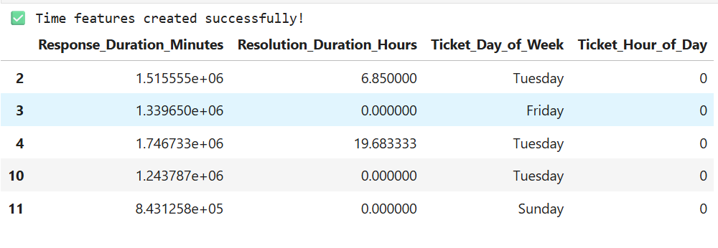
NLP Feature Engineering
Sentiment Analysis (VADER):
Extracted sentiment score (description_sentiment) from each ticket description.
TF-IDF Vectorization:
Converted ticket descriptions into numerical vectors capturing keyword importance.

Slide 24
Feature Engineering Summary
Final Feature Categories:
Numerical: Age, response & resolution durations, sentiment score
Categorical: Ticket type, priority, channel, day of week
Textual: TF-IDF features from descriptions
Target: Binary → is_satisfied = 1 (ratings ≥ 4), 0 (ratings ≤ 3)

Slide 25
Model Architecture
Model Used: Random Forest Classifier
Reason:
Handles both categorical and numerical data
Resistant to overfitting and interpretable
Works well with imbalanced datasets (class_weight='balanced’)
Pipeline Setup:
Combined numeric, categorical, and text processing using ColumnTransformer
End-to-end training in a single Pipeline

Slide 26
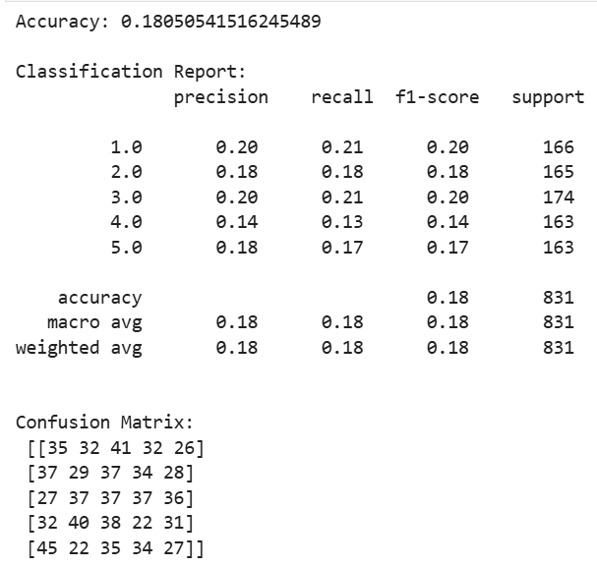
Model Evaluation Metrics
Evaluation Metrics Used:
Accuracy
Precision, Recall, F1-score
Confusion Matrix

Slide 27
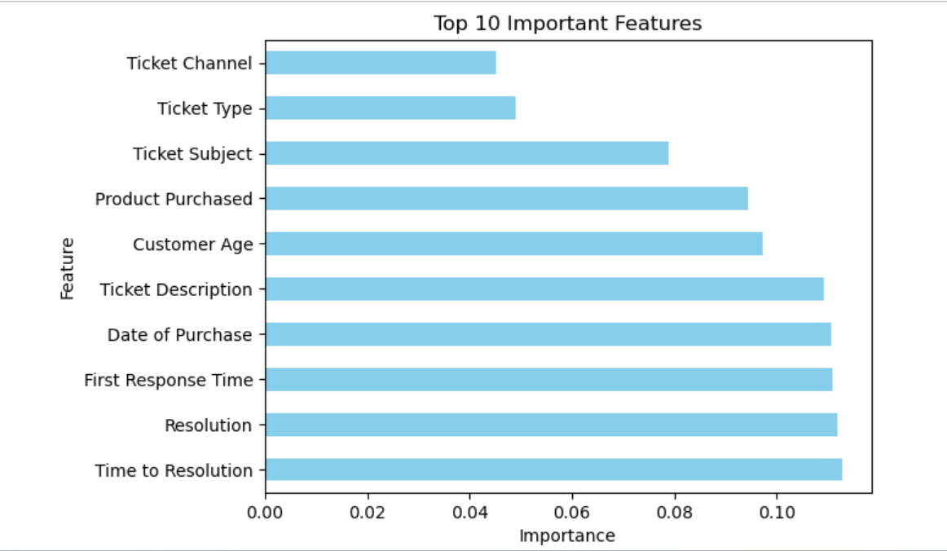
Key Insights
Resolution Duration and Sentiment Score were the top predictors of satisfaction.
Tickets with negative sentiment and high-resolution time are most likely to get low ratings.
High-priority tickets generally show higher satisfaction if resolved quickly.
Text analysis revealed that complaints with words like “delay”, “refund”, or “broken” correlate with low scores.

Slide 28
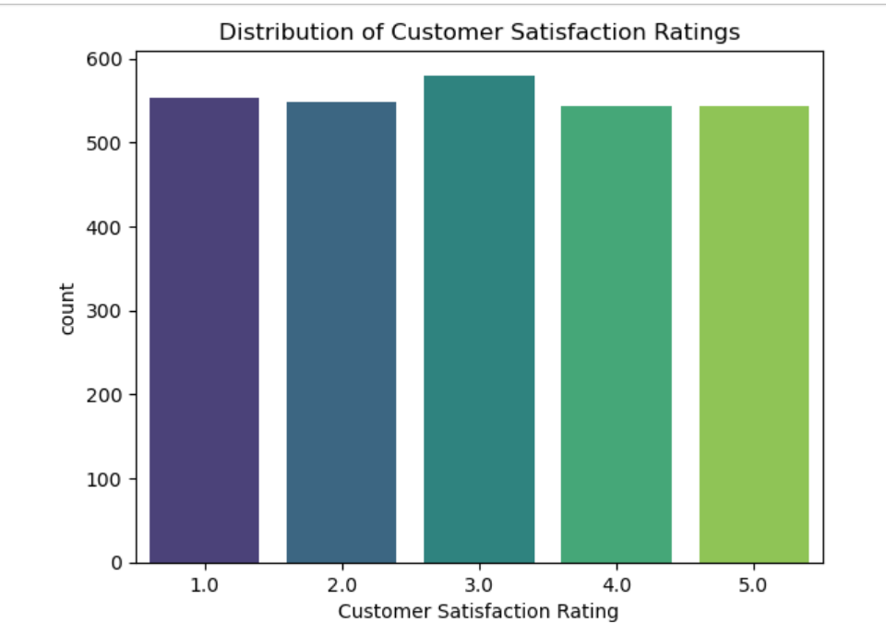
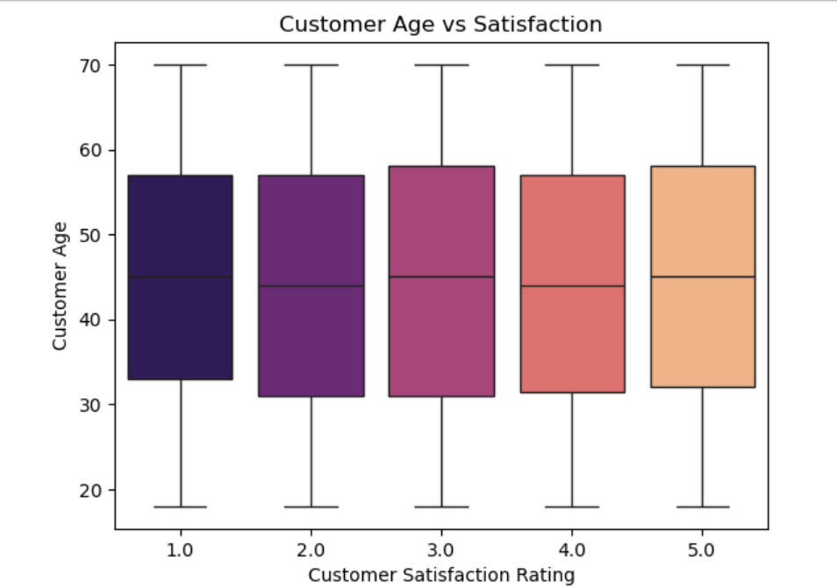
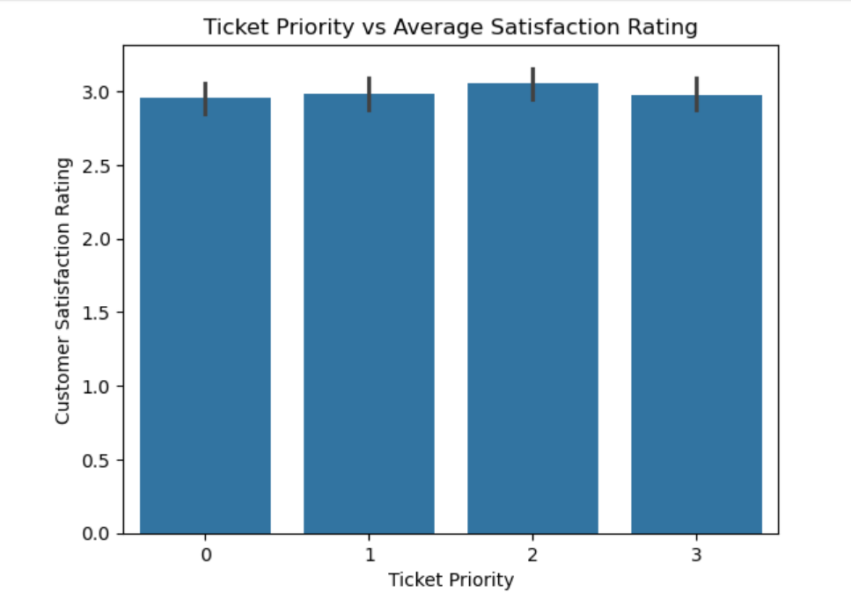
Visual Results

Slide 29
Business Recommendations
Reduce first response time — faster responses lead to higher satisfaction.
Prioritize tickets with negative sentiment for quick escalation.
Automate sentiment detection to flag high-risk customers.
Use dashboard tracking satisfaction trends by ticket type and channel.

Slide 30
Limitations & Future Work
Limitations:
Small dataset size and slight imbalance.
Sentiment analysis might not capture sarcasm or context.
Model can’t yet predict satisfaction in real-time.
Future Enhancements:
Use deep learning (BERT) for better text understanding.
Integrate real-time ticket monitoring system.
Add visualization dashboards in Power BI or Streamlit.

Slide 31
Tools & Technologies
Category | Tools Used
Language | Python
Libraries | Pandas, Scikit-learn, VADER, Matplotlib, Seaborn
ML Techniques | Random Forest, TF-IDF, Sentiment Analysis
Environment | Jupyter Notebook, Google Colab

Slide 32
Conclusion
Successfully built a model to predict customer satisfaction using both structured and text data.
Delivered actionable insights for improving support performance.

Slide 33

Project 3: IBM HR Analytics Employee Attrition & Performance Analysis

Slide 34
Introduction
In today’s competitive work environment, retaining skilled employees is a major challenge for organizations. High attrition not only increases recruitment costs but also affects productivity and team morale.
This project, “IBM HR Analytics Employee Attrition & Performance,” focuses on understanding the key factors influencing employee turnover using real-world HR data. By applying data analytics and machine learning techniques, the goal is to predict which employees are likely to leave and identify actionable insights that can help HR teams improve retention strategies.

Slide 35



Project Overview
Objective: Analyze employee data to understand and predict attrition patterns.
Scope: Explore factors driving attrition and recommend strategies to reduce employee turnover.
Dataset: IBM HR Analytics Employee Attrition Dataset. Tools: Python ( Pandas, Seaborn, Scikit-learn ), SQLite, SHAP.

Slide 36
Problem Statement
High employee attrition affects productivity, morale, and costs.
Hard to identify early signs of employee churn.
The challenge: Identify why employees leave and predict who might leave next.
Goal: Build a machine learning model that helps HR take proactive retention actions.

Slide 37

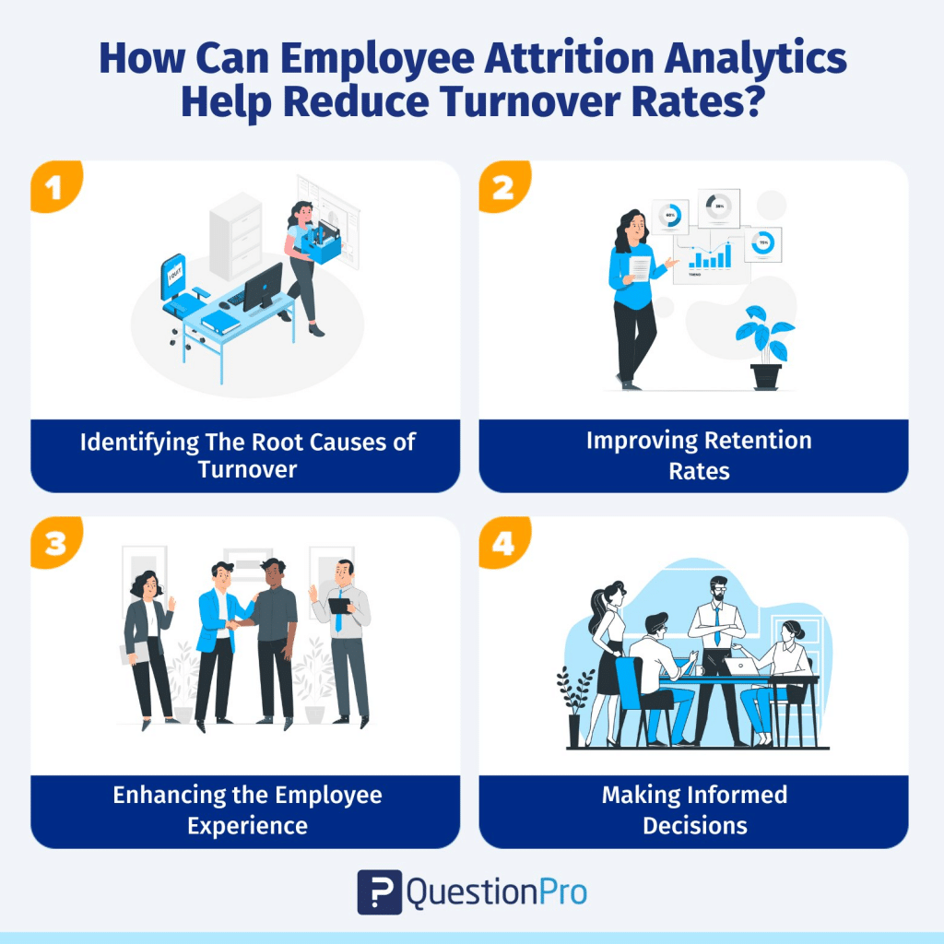
Business Objective
Identify the key drivers behind attrition.
Understand the relationship between performance and attrition.
Create predictive models for attrition risk.
Provide actionable insights for HR strategy.

Slide 38
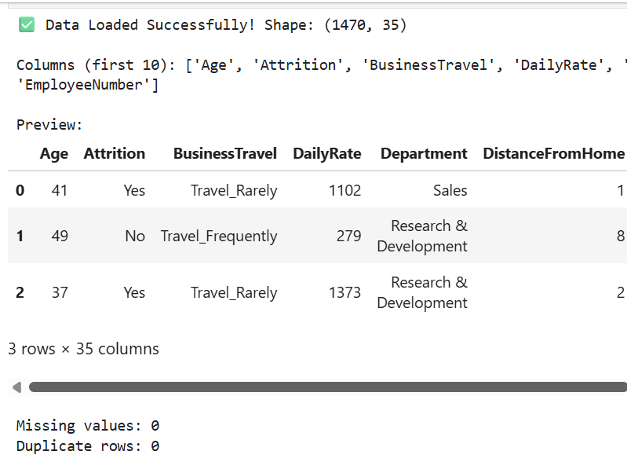
IBM HR Dataset
Source: IBM HR Analytics Dataset Rows: 1,470 | Columns: 35
Target: Attrition ( Yes / No )
Key Features:
Age, Gender, Marital Status
Department, Job Role
Years at Company, Monthly Income
Performance Rating, Work-Life Balance

Slide 39
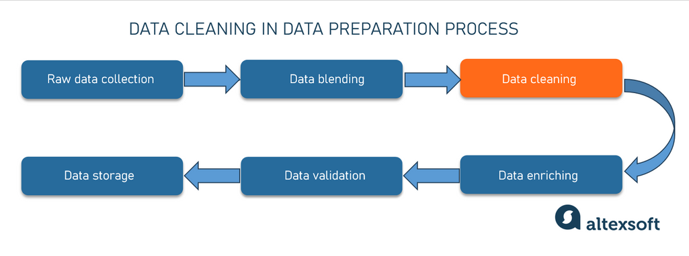
Data Cleaning and Preprocessing
Essential Steps for Preprocessing Data
Checked for duplicates and missing values – None found.
Converted categorical data to numerical using:
One-Hot Encoder for nominal features.
Ordinal Encoder for ordered Satisfaction levels
Created balanced dataset using SMOTE.

Slide 40
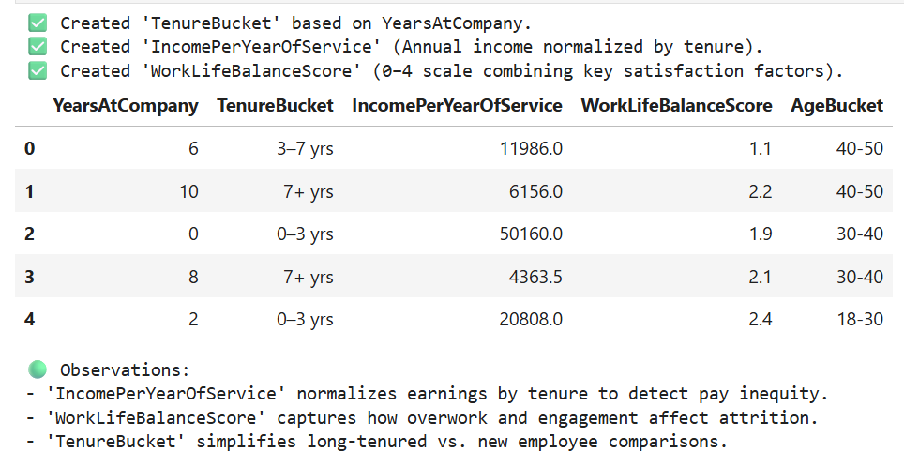
Feature Engineering
New features created to enhance model learning:
TenureBucket: Groups employees by company experience ( 0-3, 3-7, 7+ years ).
IncomePerYearOfService: Annual income per year worked.
WorkLifeBalanceScore: Combination of balance, overtime, and involvement scores.

Slide 41
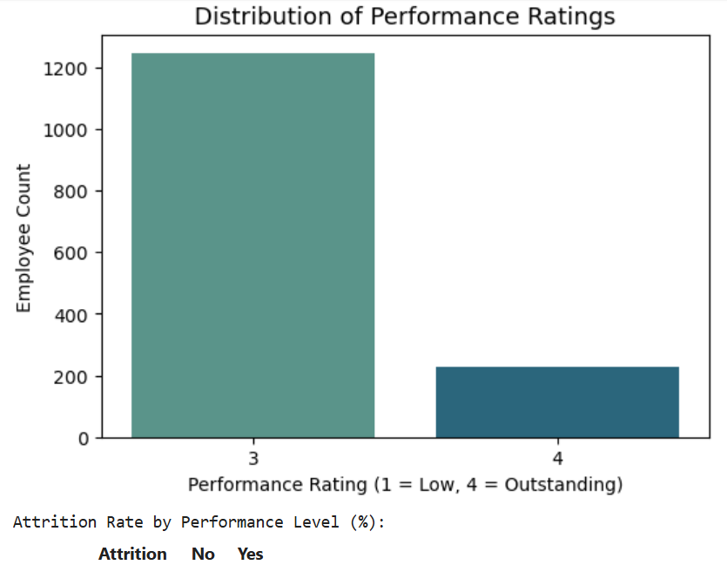
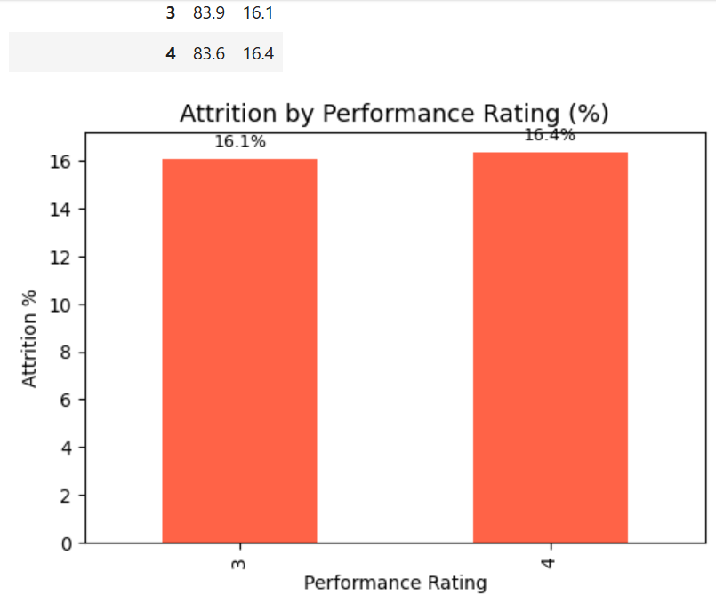
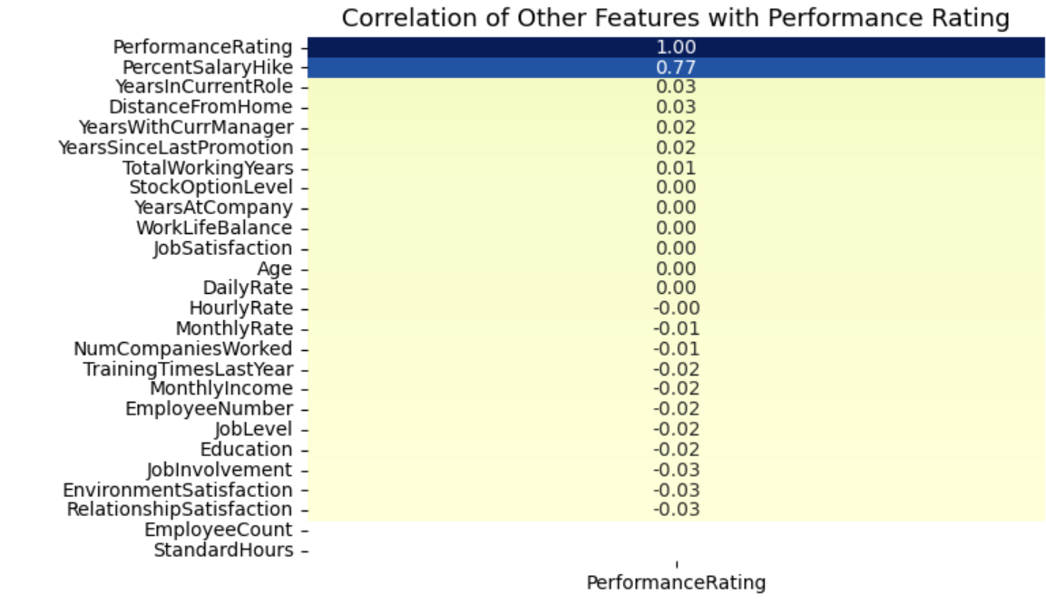
SQL Insights
Stored clean data in SQLite for queries.
Executed business queries such as:
Avg. Monthly Income by Job Role for Attrited Employees.
Employee Count by Department.
.

Slide 42
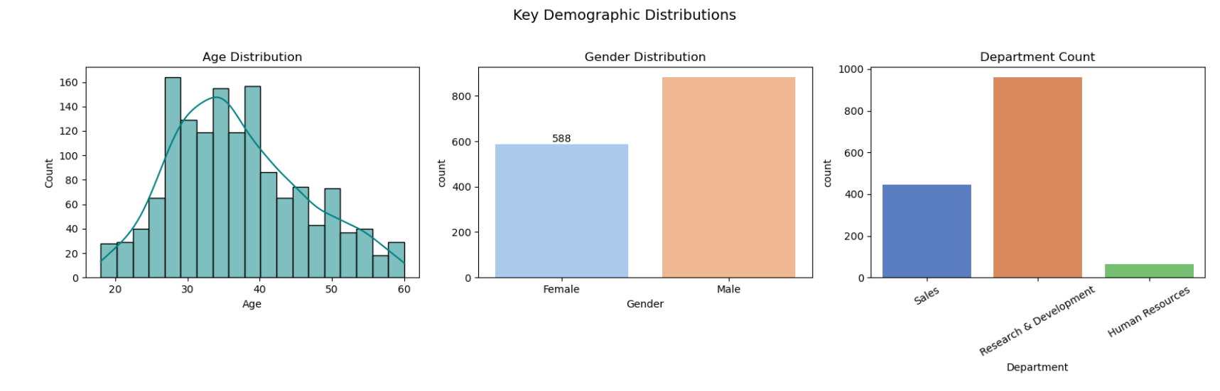
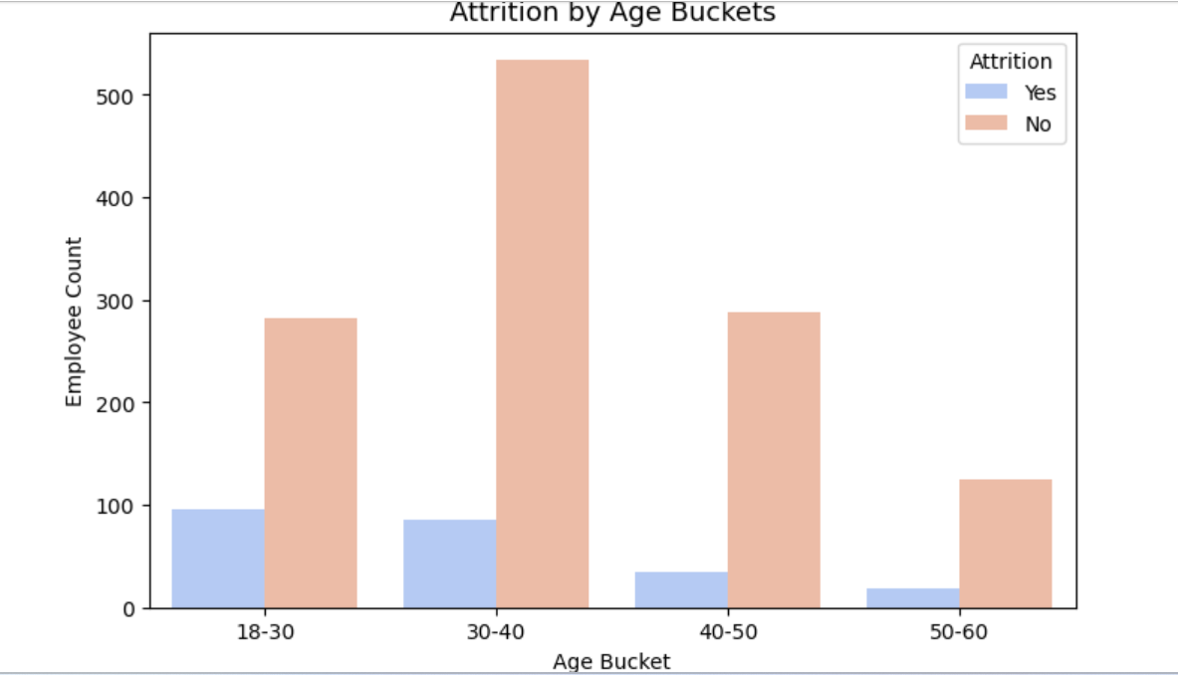
Exploratory Data Analysis (EDA)
Key Insights:
Overall attrition ≈ 16 %.
Younger employees ( 18-30 ) leave more often.
High attrition in Sales and R&D departments.
Frequent overtime and low income linked to churn.

Slide 43



Analyzing Employee Performance and Attrition
Employee Performance
Employee Attrition
Evaluating how performance impacts attrition rates
Understanding the relationship between attrition and performance

Slide 44
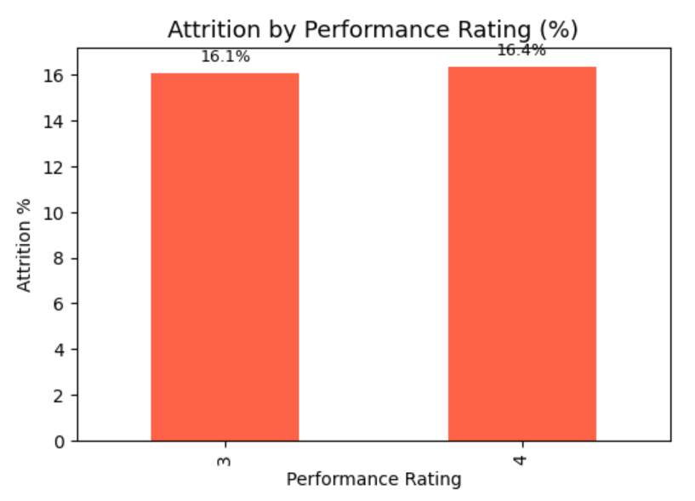
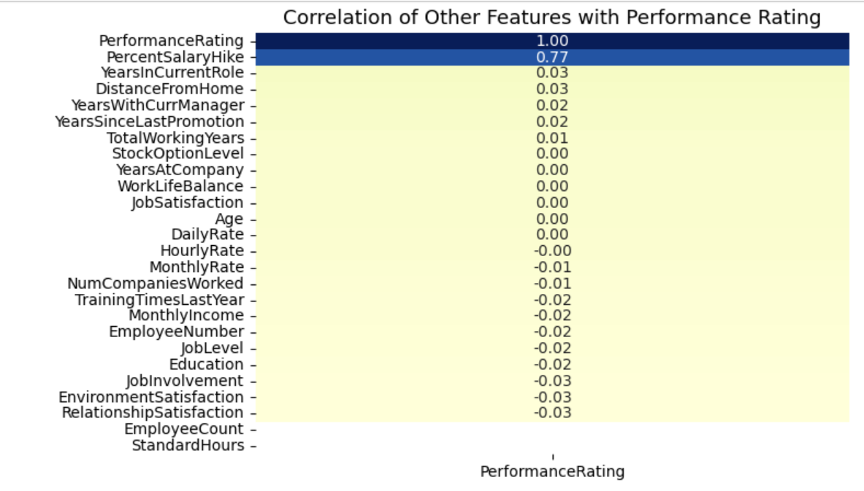
Performance Analysis
Examined relationship between Performance Rating and Attrition.
Observation: Mid-performers (rating 2–3) leave more often than top performers.
Correlation analysis done to find performance-linked factors.

Slide 45
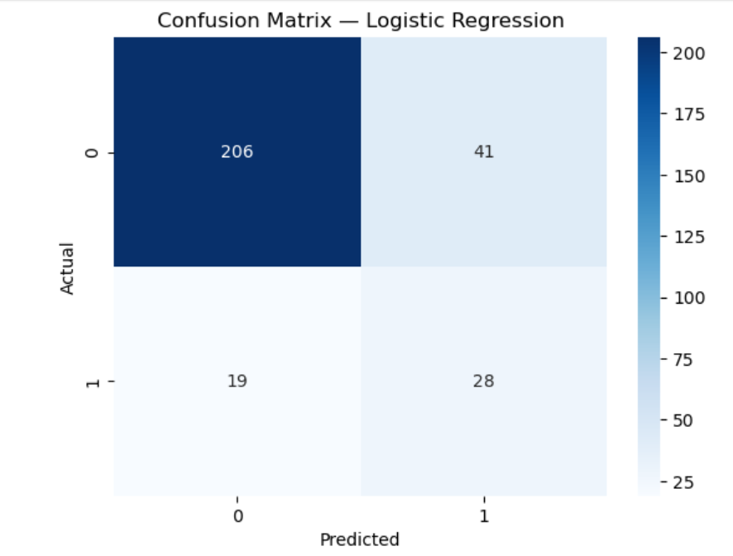


Modeling Training
Overview of Machine Learning Techniques
Machine Learning Models Used:
Logistic Regression (baseline)
Random Forest Classifier
Gradient Boosting Classifier
Metrics Evaluated: Precision, Recall, F1-Score, ROC-AUC
Best Model: Random Forest – High ROC-AUC (~0.88)

Slide 46

Model Explainability(SHAP and Feature Importance)
Understanding Model Interpretability and Insights
Interpretability Approach:
Used SHAP values to explain Random Forest predictions.
Used Permutation Importance as fallback for interpretability.
Top Predictors:
1. MonthlyIncome, 2. OverTime, 3. WorkLifeBalance,4. TenureBucket, 5. Age
85%
65%
Model Accuracy Rate
SHAP Values Explained
The model predicts attrition effectively.
Key features driving employee attrition identified.

Slide 47

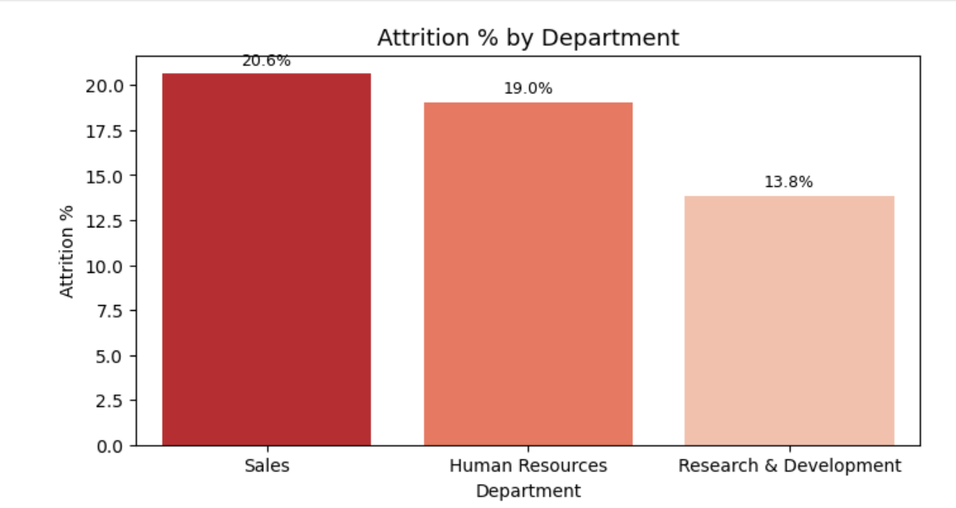
Attrition by Demographics
Age & Gender Analysis:
Attrition higher among younger and male employees.
Departmental Trends:
Sales Department: Highest attrition (~21%)
R&D: Moderate (~19%)
HR: Lowest (~14%)

Slide 48
Key Findings and Recommendations
1. Compensation & Workload:
Low income + high overtime = higher attrition risk. → Review pay structure and manage workloads fairly.
2. Work-Life Balance:
Poor balance → increased churn. → Offer flexible hours & wellness programs.
3. Tenure:
Early leavers (<3 years) common. → Strengthen onboarding and mentoring.
4. Performance:
Mid-level performers often leave. → Provide clear promotion & skill paths.

Slide 49
Challenges Faced
1. Data Understanding: Interpreting HR metrics like JobInvolvement and EnvironmentSatisfaction required studying the data dictionary carefully.
2. Imbalanced Data: Attrition “Yes” cases were rare, causing biased results — handled using SMOTE and class-weight balancing.
3. Feature Engineering: Merging factors like OverTime and WorkLifeBalance into new scores (e.g., WorkLifeBalanceScore) improved model accuracy.
4. Model Explainability: Learning to interpret SHAP values clarified which features most influenced attrition.

Slide 50
Conclusion and Future Improvements
Conclusion:
Developed a reliable model to predict attrition risk.
Provided interpretable insights for HR decision-making.
Balanced technical ML work with business understanding.
Future Enhancements:
Add real-time HR dashboard (Power BI / Streamlit).
Include employee feedback or sentiment analysis.
Deploy model via HRMS integration.

Slide 51
Thank You
Links:
Google Drive Folder: https://drive.google.com/drive/folders/12Ybhj9kH6QZhNhkSFCUy86Ehg7vBB28t?usp=sharing
GitHub Repository: Namitha-022602/Unified-Mentor-Internship-Projects: Three-project portfolio including - Supply Chain Dashboard, IBM HR Attrition, and Customer Satisfaction.

